Slide 1

Design and analysis of 2.4Ghz clock generating spur reduced fractional-N PLL using 28nm
TEAM MEMBERS:
K.NIKHIL SAI : RA1411004010334
Y.NAGARJUNA : RA1411004010345
S.V.SITA RAMIAH : RA1411004010351
PROJECT GUIDE : Mrs.J.K.KASTHURI BHA
Assistant Professor(Sr.G)

Slide 2
ABSTRACT
The spurious tones in the output of a fractional-N PLL can be reduced by replacing the delta sigma modulator with a new type of digital quantizer and adding a charge pump offset combined with a sampled loop filter. It describes the underlying mechanisms of the spurious tones, proposes techniques that mitigate the effects of the mechanisms, and presents a phase noise cancelling 2.4GHz ISM-band CMOS PLL that demonstrates the techniques.

Slide 3
INTRODUCTION
Phase locked loop that maintains a constant required frequency in the circuit.
In simple PLL circuit consisting of variable frequency oscillator and phase detector in a feedback loop.
The spurious tones in the output of a fractional N-PLL can be reduced by replacing the delta sigma modulator with a new type of digital quantizer and adding a charge pump offset combined with a sample loop filter.
PLL helps the VCO to maintain a constant output.

Slide 4
Objective
To design a fractional N-PLL using 28nm :
To provide high speed frequency sources that can be accurately set with very high resolution.
To get an accurate value we are using fractional N-PLL instead of integer PLL.
This is closed loop system which helps to be resistant against external factors which is in a phase locked loop with VCO.

Slide 5
Literature
Federico Bizzarri,” On the Mechanisms Governing Spurious Tone Injection in Fractional PLLs” IEEE TRANSACTIONS ON CIRCUITS AND SYSTEMS—II: EXPRESS BRIEFS, VOL. 64, NO. 11, NOVEMBER 2017
Fractional phase-locked loops driven by modulators there can be spurious tones in the power spectral density (PSD) of output signals
The PSDs of the sequences used to drive the frequency divider are spur-free.
Undesirable nonlinear effects notably occurring in the charge pump (CP).
The static and dynamic mismatch of the CP and its interaction with the digital delay usually present in the reset path of the phase-frequency detector
compact and simple model is presented allowing the onset of spurs and their magnitude to be reliably estimated
Gyu-Seob Jeong,” A 0.015-mm2 Inductorless 32-GHz Clock GeneratorWith Wide Frequency-Tuning Range in28-nm CMOS Technology” IEEE TRANSACTIONS ON CIRCUITS AND SYSTEMS—II: EXPRESS BRIEFS, VOL. 64, NO. 6, JUNE 2017.
This brief illustrates the design of an inductorlesshigh-speed clock generator. Compared to inductance-capacitance(LC) oscillators, ring oscillators are used in order to achieve awide frequency-tuning range with a small chip area
Using cascaded phase locked loop we reduce the spurious phase noise of oscillator
The prototype chip was fabricated in 28-nm complementary metal oxide semiconductor (CMOS) technology
A.A.Abidi, “Phase noise and jitter in CMOS ring oscillators,” IEEE J. Solid-State Circuits, vol. 41, no. 8, pp. 1803–1816, 2006
A simple, physically based analysis illustrate the noise processes inCMOSinverter-based and differential ring oscillators.
A time-domain jitter calculation method is used to analyze the effects of white noise, while random VCO modulation most straightforwardly accounts for flicker (1/f ) noise.
Analysis shows that in differential ring oscillators, white noise in the differential pairs dominates the jitter and phase noise, whereas the phase noise due to flicker noise arises mainly from the tail current control circuit.
This is validated by simulation and measurement. Straightforward expressions for period jitter and phase noise enable manual design of a ring oscillator to specifications, and guide the choice between ring and LC oscillator.

Slide 6
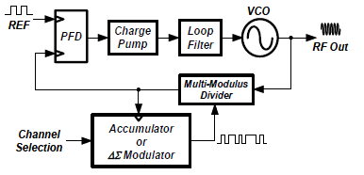
System/Architecture diagram

Slide 7
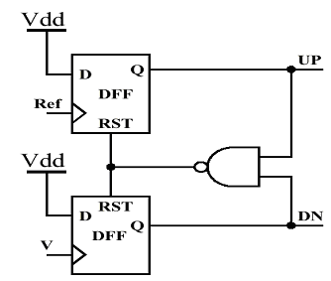
Phase Frequency Detector
A phase detector or phase comparator is a frequency mixer, analog multiplier that generates a voltage signal which represents the difference in phase between two signal inputs.
It is an essential element of the phase locked loop.
In phase frequency detector we use RS latch.
Here the data is reset to zero in every cycle and data is not stored
and runs on the new data received.
The phase frequency detector runs on the set reset logic.

Slide 8
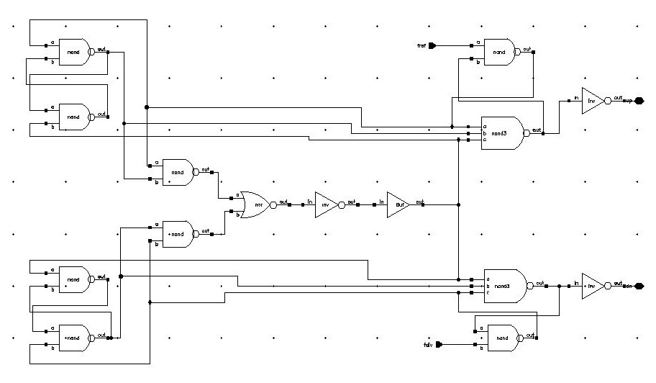
Phase Frequency Detector(PFD)

Slide 9
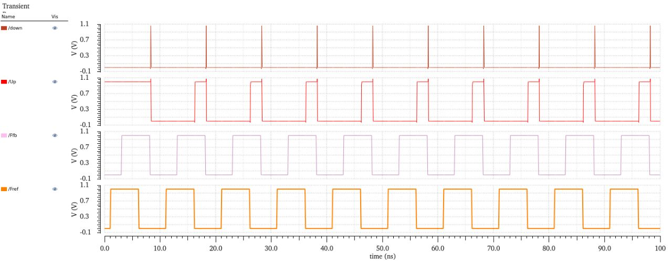
Output of PFD
PFD down conversion
PFD up conversion
feedback frequency
Reference frequency

Slide 10
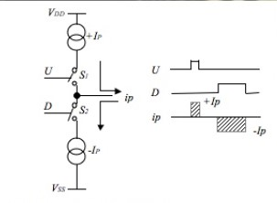
Charge Pump
A charge pump is a kind of DC to DC converter that uses capacitors for energetic charge storage to raise or lower voltage.
Charge-pump circuits are capable of high efficiencies as high as 90–95% in
some cases.
A PLL charge pump is merely a bipolar switched current source.
Charge pump can give output in the form of positive and negative
current pulses.
It cannot produce higher or lower voltages than its power
and ground supply levels.

Slide 11
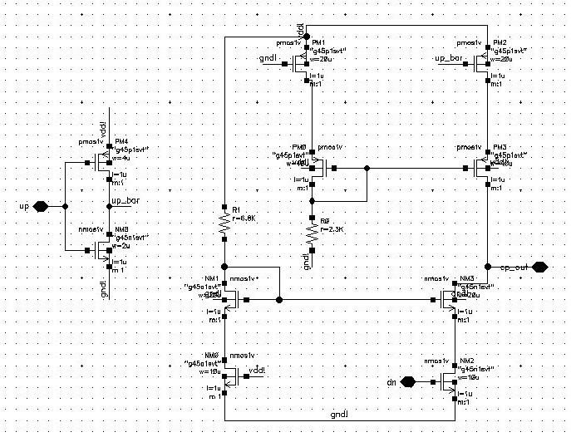
Charge Pump

Slide 12
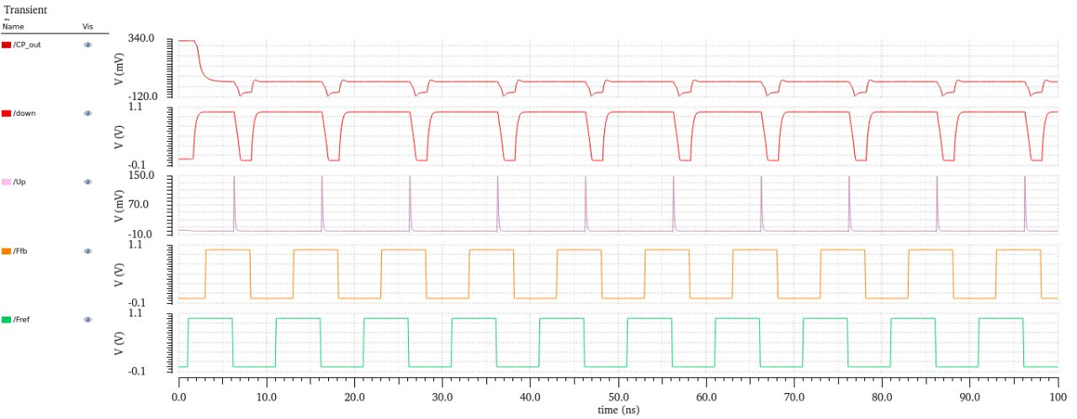
Output Of Charge Pump
Charge pump out
PFD down
conversion
PFD up
conversion
Feedback
frequency
Reference
frequency

Slide 13
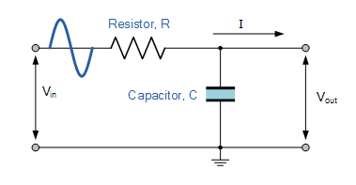
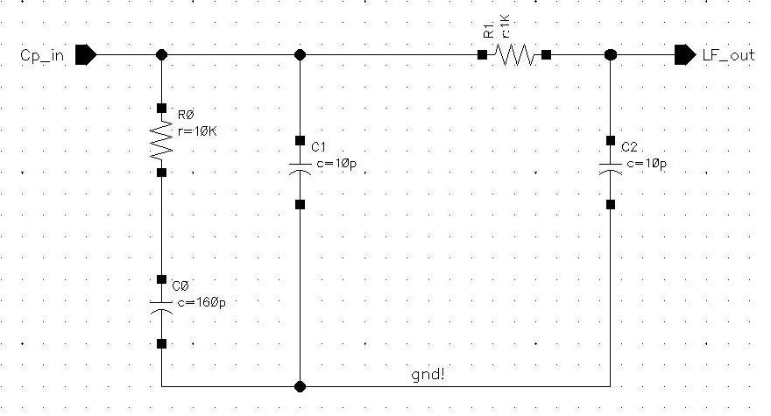
Loop Filter
Here a low pass filter is used as a loopfilter.
A low-pass filter (LPF) passes signals with a frequency lower than a certain cut off frequency and attenuates signals with frequencies higher than the cutoff frequency.
Low pass filter eliminates the noise signals with frequencies higher than cut off frequency.
To attain higher efficiencies a higher order loop filter can be used but it increases space occupancy so a 3rd order low pass filter is used.
Low pass filter governs the frequency agility and determines loop stability.

Slide 14
Voltage Controlled Oscillator
A voltage controlled oscillator can be used for frequency modulation or phase modulation by applying a modulating signal to the control input.
Here to maintain a stability in the input,phase locked loop with the fractional dividers is used to maintain an approximate value to the input.
However a voltage controlled oscillator is able to give output based on its input without a PLL.
To maintain a stability in the input and output PLL is used here.

Slide 15
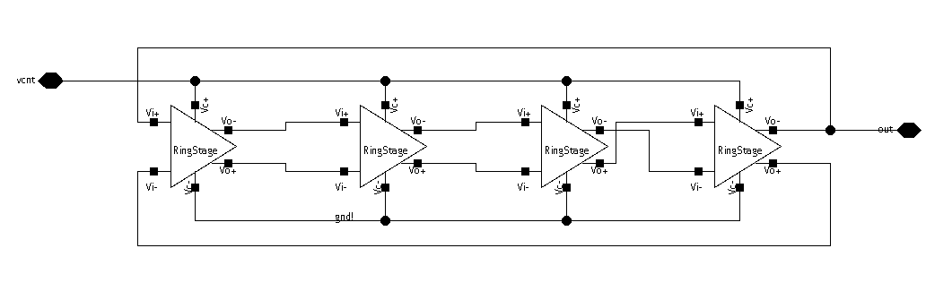
Voltage Controlled Oscillator
Here,a voltage controlled ring oscillator of double ended outputs is used.
The usage of single ended output transistors results in increase in the number of transistors so double ended output transistors are used.

Slide 16
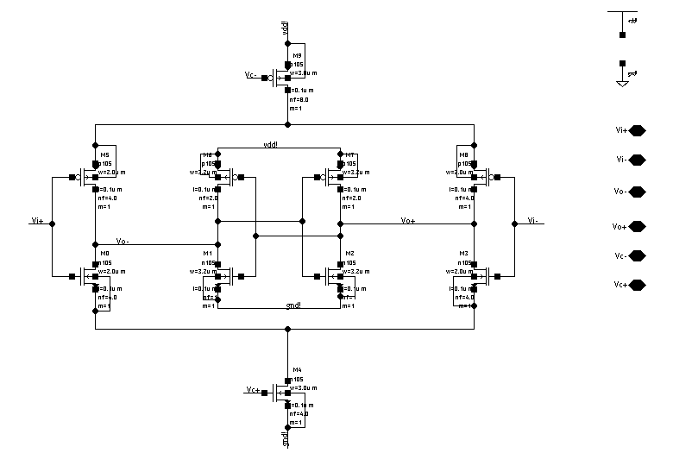
Voltage Controlled Oscillator

Slide 17
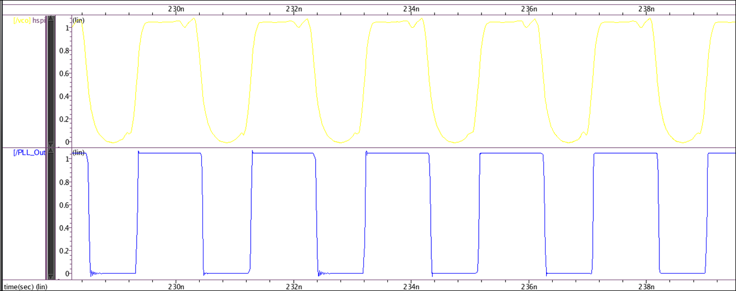
VCO Output Without And With PLL
VCO out=2.35Ghz
PLL out=2.4Ghz

Slide 18
Delta sigma fractional n-dividers
If the sequence is divide by n and divide by (n + 1) is periodic, spurious signals appear at the VCO output in addition to the desired frequency.
Delta-sigma fractional-n dividers overcome this problem by randomizing the selection of n and (n + 1), while maintaining the time-averaged ratios.
Output = input/n

Slide 19
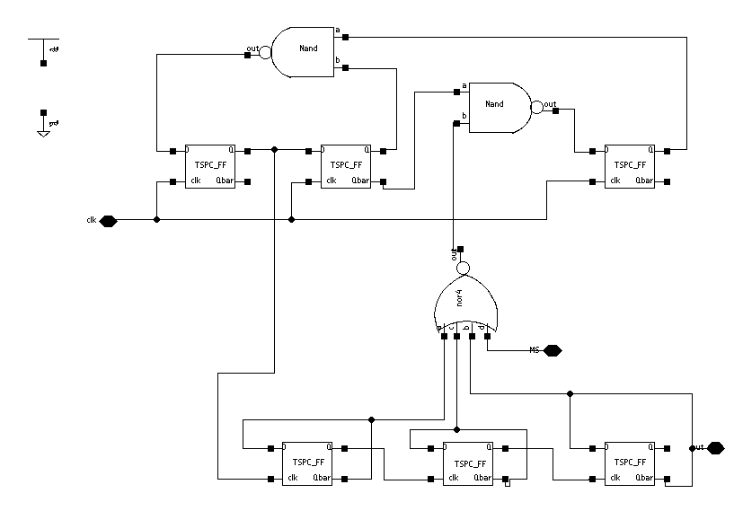
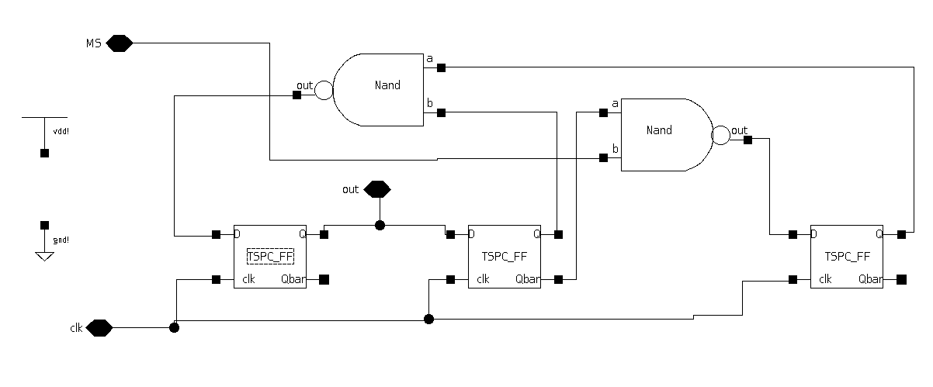
32/33(L) and 4/5(R) delta sigma fractional-n dividers

Slide 20
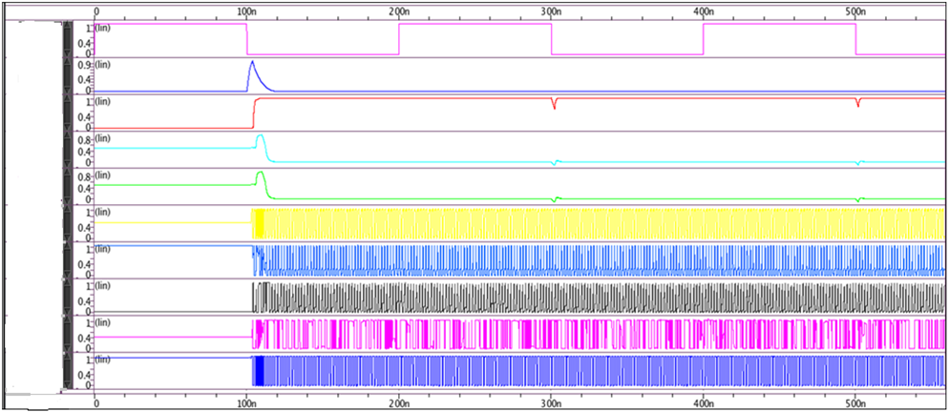
OUTPUTS
Fref=5mhz
Up
down
Charge pump
Loop
filter
VCO
Div 2
Div 5
Feedback frequency
PLL out

Slide 21
Software Requirement
Language : SPICE
Software : HSPICE
Technology : 28nm

Slide 22
CONCLUSION
TERMS | VOLTAGE | INPUT | OUTPUT
Voltage controlled oscillator | 0.65 | 10MHz | 2.387GHz
VCO with PLL | 1.6 | 5MHz | 2.4GHz
PLL locking range | 1.1 | 10MHz | 100ns
PLL locking range | 1.6 | 5MHz | 0.82ns
TERMS | POWER
Phase Frequency Detector | 4.43mw
Loop Filter(low pass filter) | 1.84mw
Div 2/3 | 267.1ᶙw
Div 4/5 | 17.3ᶙw
Div 32/33 | 37.5ᶙw
Total power | 16.56mw

Slide 23
References
[1] S. Callegari, F. Bizzarri, and A. Brambilla, “Optimal quantization noise management in wideband fractional-N PLLs,” in Proc. IEEE Int. Symp3. Circuits Syst. (ISCAS), Lisbon, Portugal, May 2015, pp. 561–564.
[2] S. B. Sleiman and M. Ismail, “Multimode reconfigurable digital modulator architecture for fractional-N PLLs,” IEEE Trans. Circuits Syst. II, Exp. Briefs, vol. 57, no. 8, pp. 592–596, Aug. 2010.
[3] D. Gaied and E. Hegazi, “Charge-pump folded noise cancelation in fractional-N phase-locked loops,” IEEE Trans. Circuits Syst. II, Exp. Briefs, vol. 61, no. 6, pp. 378–382, Jun. 2014.
[4] H. Mo and M. P. Kennedy, “Masked dithering of MASH digital deltasigma modulators with constant inputs using linear feedback shift registers,” IEEE Trans. Circuits Syst. I, Reg. Papers, vol. 63, no. 8, pp. 1131–1141, Aug. 2016

